Slide 1
Football Year 6- Lesson 1
Learning Objectives:
L.O 1 – Can children use teaching points to pass effectively
L.O 2 – Can children use knowledge of technique to suggest ways for peer’s to improve
Challenge 1 – Can children follow instructions & select the correct teaching point when given 2 options? (i.e Heel or instep?)
Challenge 2 – Can children use teaching points to pass with some consistent success
Challenge 3 – Can children use K+U of teaching points to help their peers improve?
Numeracy in P.E! -
Literacy in P.E! -
Inspiration in P.E! -
SoW Milestone Focus: 4 (Display an understanding of fair play, working well with others and leading a medium sized group). 5 (Field, defend and attack tactically by anticipating the direction of play). 6 (Utilise new skills in competitive situations, as an individual or part of a team).
1.Warm-up – Pupils start jogging around the playing area avoiding each other & listening, when the teacher calls out “GOAL!” children must freeze like a statue and pretend to celebrate scoring a goal! STRETCH, then repeat.
2. Passing gates – For this activity mark out a large square/rectangle. Within which lay out several passing gates with cones. Place these passing gates at three set distances apart. I.e Large gate = Red, Medium gate = Blue, Small gate = Orange. In pairs the children must dribble around the space then pass to each other through the various gates. Group pairs by ability and differentiate by asking specific pairs (L/A) to only use ‘orange’. L/A to use all 3 colours. PROGRESSION – Set a time limit, how many gates can you pass through in 1 minute!? Go!!!!
3. Shooting (technique) – Split class into groups of no more than 4. Create targets against a wall/fence (see overleaf). Each target represents a number of points, every time it is a child’s turn – allow them to take 3 shots minimum! This will enable them to attempt to correct errors whilst the movement is still fresh in their muscle memory.
M/A further away, smaller targets – Use weaker foot. L/A close to target, large target.
4. Overload! – It’s now time for the children to put the skills they have been developing to the test! For Overload the children will start to apply their skills in a scenario close to an actual game of Football. For Overload you’ll need to mark out a pitch, but you will only need one goal per pitch. Don’t worry if do not have goals cones will do just fine. The aim is simple, score a goal! To start with make sure each group has three attackers vs one defender, as the activity develops and the children progress this can be adapted to 2 vs 1 or even 2 vs 2 to really challenge the children.

Slide 2
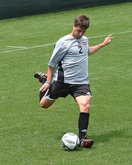
Football Year 6- Lesson 1
Teaching Points – Passing
Encourage children to:
Use the instep of the foot
to ‘push’ the ball.
toes or laces will often mean too
fast and not enough control of direction!
Teaching Points – Shooting
Place ball level w/ standing foot
Strike through the ball with laces
Keep head over the ball
(This keeps the flight of the ball low)
2. Passing Gates!
Pair children by ability.
Children must pass through the
gates, then dribble and find
another one!
PROGRESSION -
3. Shooting (technique)
Each target represents a number
of points, every time it is a child’s
turn – allow them to take 3 shots
minimum!
M/A further away, smaller targets
– Use weaker foot.
L/A close to target, large target.
2pts
5pts
2pts
“How many passes can you
do in 1 minute?! Go!”
4. Overload!
To start with make sure each group has three
attackers vs one defender, as the activity develops
and the children progress this can be adapted to
2 vs 1 or even 2 vs 2 to really challenge the children.

Slide 3
Football Year 6- Lesson 2
Learning Objectives:
L.O 1 – Can children use teaching points to shoot effectively
L.O 2 – Can children use knowledge of technique to suggest ways for peer’s to improve
Challenge 1 – Can children follow instructions & select the correct teaching point when given 2 options? (i.e Heel or laces?)
Challenge 2 – Can children use teaching points to shoot with some consistent success
Challenge 3 – Can children use K+U of teaching points to help their peers improve?
Numeracy in P.E! -
Literacy in P.E! -
Inspiration in P.E! -
SoW Milestone Focus: 4 (Display an understanding of fair play, working well with others and leading a medium sized group). 5 (Field, defend and attack tactically by anticipating the direction of play). 6 (Utilise new skills in competitive situations, as an individual or part of a team).
1.Warm-up – Pupils start jogging around the playing area avoiding each other & listening, when the teacher calls out “GOAL!” children must freeze like a statue and pretend to celebrate scoring a goal! STRETCH, then repeat.
2. Overload! – It’s now time for the children to put the skills they have been developing to the test! For Overload the children will start to apply their skills in a scenario close to an actual game of Football. For Overload you’ll need to mark out a pitch, but you will only need one goal per pitch. Don’t worry if do not have goals cones will do just fine. The aim is simple, score a goal! To start with make sure each group has three attackers vs one defender, as the activity develops and the children progress this can be adapted to 2 vs 1 or even 2 vs 2 to really challenge the children.
3. First time strike! (Moving Ball) – As we all know it is very rare when you get chance to a shot on goal when there is no defenders and the ball is calmly waiting for you to rip the net! This simple exercise starts to progress your children towards more match realistic circumstances. Using the same targets as used in the children’s Shooting practice – introduce a team mate. Ask one child to stand on the cone for 4 passes, the other children take turns in passing to this child, who passes the ball back for them to run onto & strike! Need to differentiate? Use weak foot then add a GK!
4. ‘World Cup Lottery’ – Welcome to the World Cup Lottery! Set lots of mini-pitches around your playing area. If you can set up 3 pitches, have 6 teams. 4 pitches = 8 teams etc. In each team give each child a number and place a ball in the middle of each pitch. Teams line up at opposite ends of the pitch. When you call out a number (“Number 4!”), Number 4’s run onto the pitch and try and score – the opposite number 4 must try and stop them/score themselves. PROGRESS – Call out two or three numbers at one time. Place players of similar ability on pitches where M/A will play against M/A etc.

Slide 4
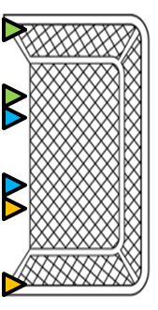
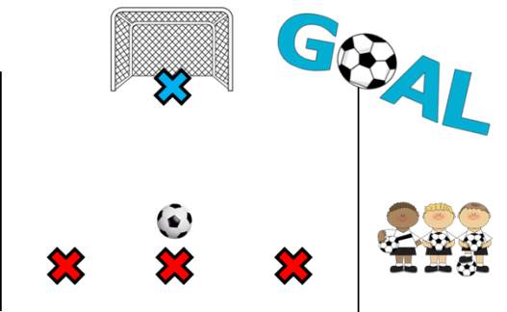
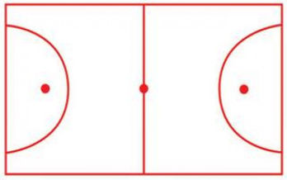
Football Year 6- Lesson 2
Teaching Points – Shooting
Place ball level w/ standing foot
Strike through the ball with laces
Keep head over the ball
(This keeps the flight of the ball low)
Teaching Points – Muscle memory
For children to be able to develop a skill, they must be allowed the opportunity to practice it continuously. Simply queuing for one
Attempt at something will not allow this to happen. Always allow children to multiple attempts if your activity requires an element of queuing.
2. Overload!
To start with make
sure each group has
3 attackers vs 1defender,
as the activity develops
and the children progress
this can be adapted to
2 vs 1 or even 2 vs 2 to
really challenge the children.
3. First time Strike!
Ask one child to stand
on the cone for 4 passes,
the other children take turns
in passing to this child,
who passes the ball back for
them to run onto & strike!
Need to differentiate? Use weak foot then add a GK!
4. World Cup Lottery!
Teams line up at opposite ends of the pitch. When you call out a
number (“Number 4!”), Number 4’s run onto the pitch and try and
score – the opposite number 4 must try and stop them/score themselves.
PROGRESS – Call out two or three numbers at one time.
Place players of similar ability on pitches where
M/A will play against M/A etc.

Slide 5
Football Year 6- Lesson 3
Learning Objectives:
L.O 1 – Can children use teaching points to shoot effectively
L.O 2 – Can children use knowledge of technique to suggest ways for peer’s to improve
Challenge 1 – Can children follow instructions & select the correct teaching point when given 2 options? (i.e Heel or laces?)
Challenge 2 – Can children use teaching points to shoot with some consistent success
Challenge 3 – Can children use K+U of teaching points to help their peers improve?
Numeracy in P.E! -
Literacy in P.E! -
Inspiration in P.E! -
SoW Milestone Focus: 4 (Display an understanding of fair play, working well with others and leading a medium sized group). 5 (Field, defend and attack tactically by anticipating the direction of play). 6 (Utilise new skills in competitive situations, as an individual or part of a team).
1.Warm-up – Pupils start jogging around the playing area avoiding each other & listening, when the teacher calls out “GOAL!” children must freeze like a statue and pretend to celebrate scoring a goal! STRETCH, then repeat.
2. First time strike! (Moving Ball) – As we all know it is very rare when you get chance to a shot on goal when there is no defenders and the ball is calmly waiting for you to rip the net! This simple exercise starts to progress your children towards more match realistic circumstances. Using the same targets as used in the children’s Shooting practice – introduce a team mate. Ask one child to stand on the cone for 4 passes, the other children take turns in passing to this child, who passes the ball back for them to run onto & strike! Need to differentiate? Use weak foot then add a GK!
3. ‘World Cup Lottery’ – Welcome to the World Cup Lottery! Set lots of mini-pitches around your playing area. If you can set up 3 pitches, have 6 teams. 4 pitches = 8 teams etc. In each team give each child a number and place a ball in the middle of each pitch. Teams line up at opposite ends of the pitch. When you call out a number (“Number 4!”), Number 4’s run onto the pitch and try and score – the opposite number 4 must try and stop them/score themselves. PROGRESS – Call out two or three numbers at one time. Place players of similar ability on pitches where M/A will play against M/A etc.
4. Conditioned Games! – Split your class into 4 teams (2 teams of your higher ability, 2 teams of your lower ability). Set up 2 pitches and ensure teams play against teams of a higher ability. Enforce rules as per progress. I.e – ‘Blue’ team are finding the level of challenge easy, ask them to complete 4 passes before they shoot at goal

Slide 6
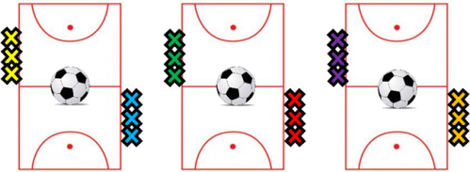
Football Year 6- Lesson 3
Teaching Points – Shooting
Place ball level w/ standing foot
Strike through the ball with laces
Keep head over the ball
(This keeps the flight of the ball low)
Teaching Points – Muscle memory
For children to be able to develop a skill, they must be allowed the opportunity to practice it continuously. Simply queuing for one
Attempt at something will not allow this to happen. Always allow children to multiple attempts if your activity requires an element of queuing.
2. First time Strike!
Ask one child to stand
on the cone for 4 passes,
the other children take turns
in passing to this child,
who passes the ball back for
them to run onto & strike!
Need to differentiate? Use weak foot then add a GK!
3. World Cup Lottery!
Teams line up at opposite ends of the pitch. When you call out a number (“Number 4!”), Number 4’s run onto the pitch and try and score – the opposite number 4 must try and stop them/score themselves. PROGRESS – Call out two or three numbers at one time.
4. Conditioned Games!
Set up 2 pitches and ensure teams play against teams of a higher ability.
Enforce rules as per progress. I.e – ‘Blue’ team are finding
the level of challenge easy, ask them to complete 4 passes
before they shoot at goal

Slide 7
Football Year 6- Lesson 4
Learning Objectives:
L.O 1 – Can children use teaching points to shoot effectively
L.O 2 – Can children use knowledge of technique to suggest ways for peer’s to improve
Challenge 1 – Can children follow instructions & select the correct teaching point when given 2 options? (i.e Heel or laces?)
Challenge 2 – Can children use teaching points to shoot with some consistent success
Challenge 3 – Can children use K+U of teaching points to help their peers improve?
Numeracy in P.E! -
Literacy in P.E! -
Inspiration in P.E! -
SoW Milestone Focus: 4 (Display an understanding of fair play, working well with others and leading a medium sized group). 5 (Field, defend and attack tactically by anticipating the direction of play). 6 (Utilise new skills in competitive situations, as an individual or part of a team).
1.Warm-up – Pupils start jogging around the playing area avoiding each other & listening, when the teacher calls out “GOAL!” children must freeze like a statue and pretend to celebrate scoring a goal! STRETCH, then repeat.
2. Possession Grids – Split the class into 4 teams, each team gets its own grid. Ensure that the L/A teams play in larger grids, M/A should be challenged by having less space to play in. In each grid the children take turns in being the defender, the other players try and keep the ball away from them by passing the ball quickly and into space. One a defender has won the ball three times, rotate who the defender is and start again!
3. Keepball – Place the two ‘M/A’ teams in a larger grid, and the two L/A teams in an even larger grid. The aim of ‘Keepball’ is for one team to attempt to keep the ball away from the other. Explain that to do this they must communicate effectively, use the passing skill effectively & be aware of the space around them. Set a target for each team. If one teams target is ‘6’, they must complete 6 passes without interception to score a goal. If the ball rolls out of the grid, the other team gets the ball. Decrease playing area to challenge M/A to think & execute quicker.
4. Conditioned Games! – Split your class into 4 teams (2 teams of your higher ability, 2 teams of your lower ability). Set up 2 pitches and ensure teams play against teams of a higher ability. Enforce rules as per progress. I.e – ‘Blue’ team are finding the level of challenge easy, ask them to complete 4 passes before they shoot at goal

Slide 8
Football Year 6- Lesson 4
Teaching Points – Shooting
Place ball level w/ standing foot
Strike through the ball with laces
Keep head over the ball
(This keeps the flight of the ball low)
Teaching Points – Passing
Encourage children to:
Use the instep of the foot
to ‘push’ the ball.
toes or laces will often mean too
fast and not enough control of direction!
2. Possession Grids
3. ‘Keepball’
M/A
L/A vs L/A – 1st 6 passes = a goal!
M/A vs M/A – 1st 6 passes = a goal!
L/A
4. Conditioned Games!
Set up 2 pitches and ensure teams play against teams of a higher ability.
Enforce rules as per progress. I.e – ‘Blue’ team are finding
the level of challenge easy, ask them to complete 4 passes
before they shoot at goal

Slide 9
Football Year 6- Lesson 5
Learning Objectives:
L.O 1 – Can children use teaching points to shoot effectively
L.O 2 – Can children use knowledge of technique to suggest ways for peer’s to improve
Challenge 1 – Can children follow instructions & select the correct teaching point when given 2 options? (i.e Heel or laces?)
Challenge 2 – Can children use teaching points to shoot with some consistent success
Challenge 3 – Can children use K+U of teaching points to help their peers improve?
Numeracy in P.E! -
Literacy in P.E! -
Inspiration in P.E! -
SoW Milestone Focus: 4 (Display an understanding of fair play, working well with others and leading a medium sized group). 5 (Field, defend and attack tactically by anticipating the direction of play). 6 (Utilise new skills in competitive situations, as an individual or part of a team).
1.Warm-up – Pupils start jogging around the playing area avoiding each other & listening, when the teacher calls out “GOAL!” children must freeze like a statue and pretend to celebrate scoring a goal! STRETCH, then repeat.
2. Keepball – Royal Rumble! – Place the two ‘M/A’ teams in a larger grid, and the two L/A teams in an even larger grid. The aim of ‘Keepball’ is for one team to attempt to keep the ball away from the other. Explain that to do this they must communicate effectively, use the passing skill effectively & be aware of the space around them. Set a target for each team. If one teams target is ‘6’, they must complete 6 passes without interception to score a goal. If the ball rolls out of the grid, the other team gets the ball. In this version when a team scores a goal, their opposition loses a player (they must run round the outside of the grid until the game is finished! Decrease playing area to challenge M/A to think & execute quicker.
3. Skill intro – Losing a defender: Combine two ability groups. 2 M/A groups work in grid 1. 2 L/A groups work in grid 2. Grid 2 should be slightly bigger than grid 1. 6 feeders on the outside of the grid with the ball. 3 pairs on the inside (3 attackers, 3 markers). Markers attempt to block the pass from feeder to attacker. Attackers attempt to receive the ball from feeder, passing it back straight away and find a new feeder to receive a pass from. Concentrate feedback on the movement of the attacker, how to lose the defender. M/A smaller space – harder to lose marker.
4. Conditioned Games! – Split your class into 4 teams (2 teams of your higher ability, 2 teams of your lower ability). Set up 2 pitches and ensure teams play against teams of a higher ability. Enforce rules as per progress. I.e – ‘Blue’ team are finding the level of challenge easy, ask them to complete 4 passes before they shoot at goal

Slide 10
Football Year 6- Lesson 5
Teaching Points – Passing
Encourage children to:
Use the instep of the foot
to ‘push’ the ball.
toes or laces will often mean too
fast and not enough control of direction!
Teaching Points – Losing a marker
To lose a marker pupils should
combine a change of pace
with a change of direction.
Blue = Slow, Red = Fast
2. ‘Keepball’
3. Losing a defender
Set time
(2 – 3 minutes)
See how many times the
‘attacker’ can catch the ball by losing the defender.
ROYAL
RUMBLE!
L/A vs L/A – 1st 6 passes = a goal!
M/A vs M/A – 1st 6 passes = a goal!
4. Conditioned Games!
Set up 2 pitches and ensure teams play against teams of a higher ability.
Enforce rules as per progress. I.e – ‘Blue’ team are finding
the level of challenge easy, ask them to complete 4 passes
before they shoot at goal

Slide 11
Football Year 6- Lesson 6
Learning Objectives:
L.O 1 – Can children use teaching points to shoot effectively
L.O 2 – Can children use knowledge of technique to suggest ways for peer’s to improve
Challenge 1 – Can children follow instructions & select the correct teaching point when given 2 options? (i.e Heel or laces?)
Challenge 2 – Can children use teaching points to shoot with some consistent success
Challenge 3 – Can children use K+U of teaching points to help their peers improve?
Numeracy in P.E! -
Literacy in P.E! -
Inspiration in P.E! -
SoW Milestone Focus: 4 (Display an understanding of fair play, working well with others and leading a medium sized group). 5 (Field, defend and attack tactically by anticipating the direction of play). 6 (Utilise new skills in competitive situations, as an individual or part of a team).
Liverpool scored a goal after making 51 passes against Bournemouth – Patience & Width!
1.Warm-up – Pupils start jogging around the playing area avoiding each other & listening, when the teacher calls out “GOAL!” children must freeze like a statue and pretend to celebrate scoring a goal! STRETCH, then repeat.
2. Conditioned Games! - Split your class into 4 teams (2 teams of your higher ability, 2 teams of your lower ability). Set up 2 pitches and ensure teams play against teams of a higher ability. Enforce rules as per progress. I.e – ‘Blue’ team are finding the level of challenge easy, ask them to complete 4 passes before they shoot at goal
3. Tactics Workshop! – Demonstrate and explain to the children that you can use different tactics to achieve success in a variety of sports. For this lesson show the children 2 defensive tactics they could employ and 2 offensive tactics. Explain the potential strengths and weaknesses of all tactics, the children must then get together and pick the tactics that they are going to try and use to help them improve as a team!
4. Conditioned Games! – Split your class into 4 teams (2 teams of your higher ability, 2 teams of your lower ability). Set up 2 pitches and ensure teams play against teams of a higher ability. Enforce rules as per progress. I.e – ‘Blue’ team are finding the level of challenge easy, ask them to complete 4 passes before they shoot at goal

Slide 12
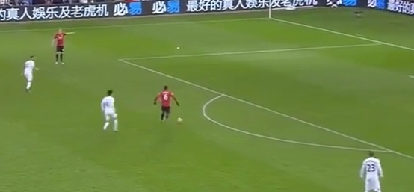
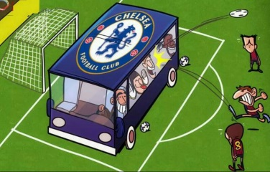
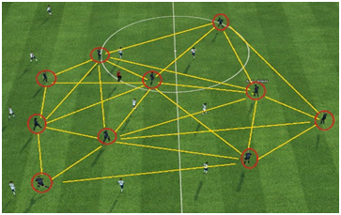
Football Year 6- Lesson 6
Teaching Points – Defensive Tactic: High Press
This tactic means the team
will try and win the ball back
as high up the pitch as they
can. Great if it works! It
requires a lot of energy and
you’ll leave a lot of space in front of the goal you’re defending.
Teaching Points –Defensive Tactic: Low Block
This tactic sees the defence
sitting very deep in front of their
own area. The defence allows the
team to have the ball unchallenged
in the middle of the pitch. It lets a team get lots of people blocking the ball. But it also lets the team close to your goal!
Teaching Points – Offensive Tactic: Direct (Long Ball)
Put simply ‘the long ball’ uses a target
man who stands close to the goal they’re
Attacking. The team kick the ball to this
player as soon as they can. It lets you move
up the pitch fast, but sometimes means your
team might loose the ball a lot!
Teaching Points –Offensive Tactic: Patience & Width
To optimise width, the attacking team
positions players out wide. Using quick
passes to move the defence left and right,
the attacking team aims to create a space
to exploit. If you can pass well, great! If not,
you may lose the ball with a lot of space behind you!
4. Conditioned Games!
Set up 2 pitches and ensure teams play against teams of a higher ability.
Enforce rules as per progress. I.e – ‘Blue’ team are finding
the level of challenge easy, ask them to complete 4 passes
before they shoot at goal

